Slide 1
BookMyEvent: A Responsive Event Landing Web Application
Team 14: Pentagon

Slide 2
TABLE OF CONTENTS
01
02
GOAL
KEY FEATURES
03
04
TECH STACK
USE CASE
05
06
TARGET USERS
SYSTEM REQUIREMENTS
07
08
PRODUCT BACKLOG
SPRINTS

Slide 3
ABOUT US
SRINIVASA DEEPASHREE
AISHWARYA HIREGOWD
VEERESH
HIREMATH
SHIVA KUMAR CHAKALI
LOKESH
NAGENDLA

Slide 4
GOAL OF THE PROJECT
To create a user-friendly, responsive web platform that allows users to discover events, book tickets, and get instant support through a chatbot.

Slide 5
KEY FEATURES
Event Discovery
Event Information
Ticket Booking
Chatbot Support
Search for events by date, type, and location.
Detailed pages with event schedules, guests speakers, sponsors, images/videos
Options for different ticket types (General, VIP) with prices and availability
24/7 assistance with booking and event queries.

Slide 6
TECHNOLOGY STACK
APP
Frontend
Chatbot
Backend
React.js
SCSS
Redux
Node.js
MongoDB
Express.js
UI development
Responsive design
State management
Server-side
Database for event and user data
Routing and server requests

Slide 7
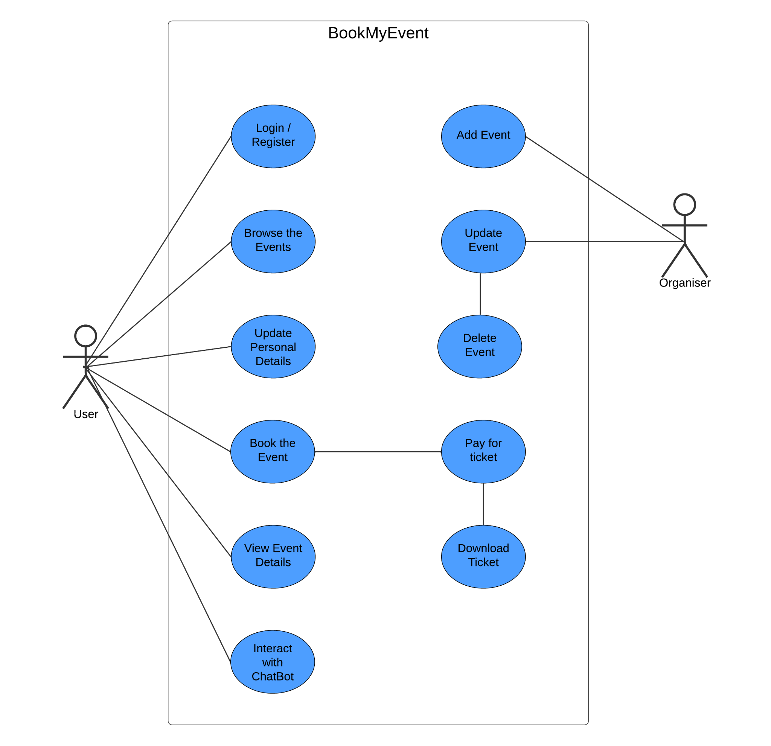
USE CASE

Slide 8
TARGET USERS
Event Attendees
Looking to easily find and book events like concerts or festivals.
Event Organizers
Looking to easily find and book events like concerts or festivals.
Sponsors
Companies promoting their services/products through event sponsorship

Slide 9
SYSTEM REQUIREMENTS
Functional Requirements
Non-functional Requirements
Manage Bookings
Register/Login
Browse and Search Events
View Event Details
Book and Pay for Tickets
Manage Bookings
Event Management (Organizers)
Chatbot Interaction
Easy-to-use, secure platform
Mobile-friendly and browser-compatible

Slide 10
PRODUCT BACKLOG
Register/Login
Browse Events
Users can create accounts and access their profiles.
Users can search for events by category, date, and location
Book Events
Payments
Users can select tickets and confirm bookings.
Users enter payment details and receive

Slide 11
SPRINTS
SPRINT 1
SPRINT 3
User Login and Registration
Event browsing
Chatbot
Booking Confirmation
QR Code Generation
SPRINT 2
Create event
Select tickets
Confirm Booking

Slide 12
User Registration and Login:
→ Users have the ability to securely register and sign in using their email address and a password.
Event Discovery:
→ search for events by title, description, organizer, etc.
Event Creation:
→ Signed users can create events.
Event Information:
→ Detailed pages with event date, place, organizer, price, etc.
Event Booking:
→ Purchase tickets for shows and events and complete payments through online transactions.
Orders:
→ View all orders and tickets..
Chatbot Support:
→ 24/7 assistance with booking and event queries.
User Manual

Slide 13
Lessons Learned: Customer Interaction
Clear Communication
Building Trust
Regular Updates
Feedback Loops
Maintaining clear communication enhances understanding and coordination.
Establishing trust through transparency fosters a positive client relationship.
Providing regular updates keeps customers informed and engaged throughout the project.
Understanding customer needs through feedback loops ensures alignment with expectations.

Slide 14
Lessons Learned: Teamwork
Open Communication
Peer Reviews
Diverse Skill Sets
Supportive Team Culture
Facilitates collaboration among team members, leading to better project outcomes.
Enhance quality assurance by allowing team members to provide constructive feedback.
Essential for achieving project goals, fostering trust and collaboration.
Bring innovative solutions to the table, leveraging the unique strengths of each member.

Slide 15
CONCLUSION
A fully responsive, secure platform for users to discover, book, and manage events seamlessly, with 24/7 chatbot support for queries.

Slide 16

THANKS!

